Slide 1
Release Revolution
Days to Hours in the UK Government
Matthew Bradley
Notes:
Who am I?
Matt Bradley – IS Project Manager. I’d just like to thank Gene for inviting me here to talk to you guys today.
I have to say that I’ve already been significantly inspired from the presentations I’ve already heard so far, hearing about the incredible progress organizations the world over are making in DevOps.

Slide 2
What am I here to talk about?
How we revolutionised the way we deploy our application code
Applying DevOps technology in a large organisation that has traditionally been well behind the technology curve
How a critical business problem led us to DevOps
The range of benefits automation brought us
The challenges we faced along the way and in some cases still face
How we’re positioned for the future
Notes:
Working for Her Majesty’s Civil Service I use the word revolution lightly.
This presentation is really about how a very large organization at the beginning of its DevOps journey revolutionized the way we release our applications.
I’m going to walk through a project that I commissioned and managed through 2013 - 14.
I’ll be focusing on…
Applying DevOps technology to a super tanker of an organisation, with a reputation for being well behind the technological curve
How a business problem the pain of vast manual deployments led us to DevOps
The benefits automation brought us
The challenges we faced along the way
To do this I feel I should set the scene and provide some context around what we do and IT within the UK government.

Slide 3
What is the DWP
The Department for Work and Pensions (DWP) is responsible for welfare, pensions and child maintenance policy. As the UK’s biggest public service department it administers the State Pension and a range of working age, disability and ill health benefits to over 22 million claimants and customers
Its core operational services are Job Centre Plus (Working Age Benefits), Benefits Agency, Pension Service and Child Maintenance Service.
DWP is a ministerial department, supported by 14 agencies and public bodies
A central IT directorate is responsible for the whole Department
Notes:
Above is the formal description of what the DWP does, but essentially we turn the governments’ welfare policy into a reality, by administering a number benefits and services. Having one of the largest welfare systems in the world we therefore have a lot of customers, pay out a lot of money and as you might expect have a significant head count to deliver these services.
For those from the UK you’ll probably be very familiar with the what the DWP does, for those that are not, operationally we deliver these services increasingly online, through national call centres, through local government and through client facing branches.

Slide 4
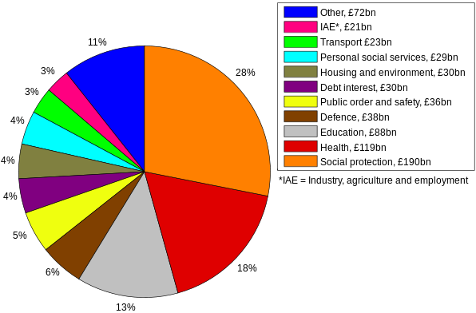
Scale
In excess of 100,000 FTE’s.
4th largest UK employer.
6 Corporate Sites across the UK and Northern Ireland
Approx. 1,000 operational sites, delivering services to UK Citizens in Jobcentres, contact centres and benefit processing centres across the UK
Largest UK Public Spender by some margin
Consistently high profile in the UK media and Politics
Notes:
I thought I’d run through some headline statistics to give you all an idea of the scale of the organisation.
We are the third largest employer in the UK next to the NHS and Royal Mail, with in excess of >100,000 employees.
6 corporate centers, 1000+ Sites, unsurprisingly for a large organisation this number can flex.
It is an enormous organisation. It has been delivering services in roughly its current form since 1950’s and there are a number of ‘legacy’ systems.
The department adopted an outsourced IT model in the 1990’s. When you consider the supplier framework that supports DWP the complexity and scale of the organisation is even higher.

Slide 5
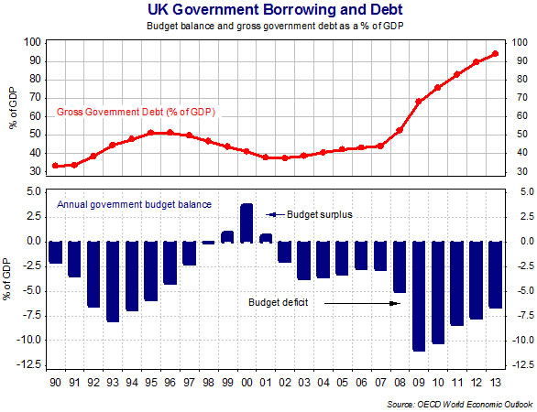
The Public Sector Net Cash Requirement – AKA “The Deficit”
Notes:
The graph here, outlines possibly the most important current contextual driver within the UK Public Sector. As a nation we spend significantly more than we receive in taxation. All political parties are now committed to reducing public spending and the national debt.
From an IT perspective this impacts us in different and some might say conflicting ways.
As a department we are committed to reducing both operating cost. Everything we do is under enormous scrutiny both internally and externally to provide value for money and cost reduction.
As the largest consumer of Public Funds the policy that underpins the DWP is under major reform.
Both cost saving and reform projects are driving significant IT change. We’re therefore under pressure to do more for less in an environment of unprecedented change.

Slide 6
The Child Maintenance Service…
Part of DWP since 2010
Handles all Applications for Child Maintenance
Calculates how much maintenance is due (based on legislation)
Collects maintenance
Takes Enforcement and Legal action (in the event of non-payment)
Transfers maintenance from the paying parent to the receiving parent
As of 2014 a charge is levied for this service
Notes:
The responsibility for Child Maintenance sits within the DWP.
It’s not compulsory to use the system, parents are encouraged to come to an amicable and private solution where possible.
The following bullets briefly outline the core functional areas.
Applications and Calculation
Collection
Enforcement
Payments

Slide 7
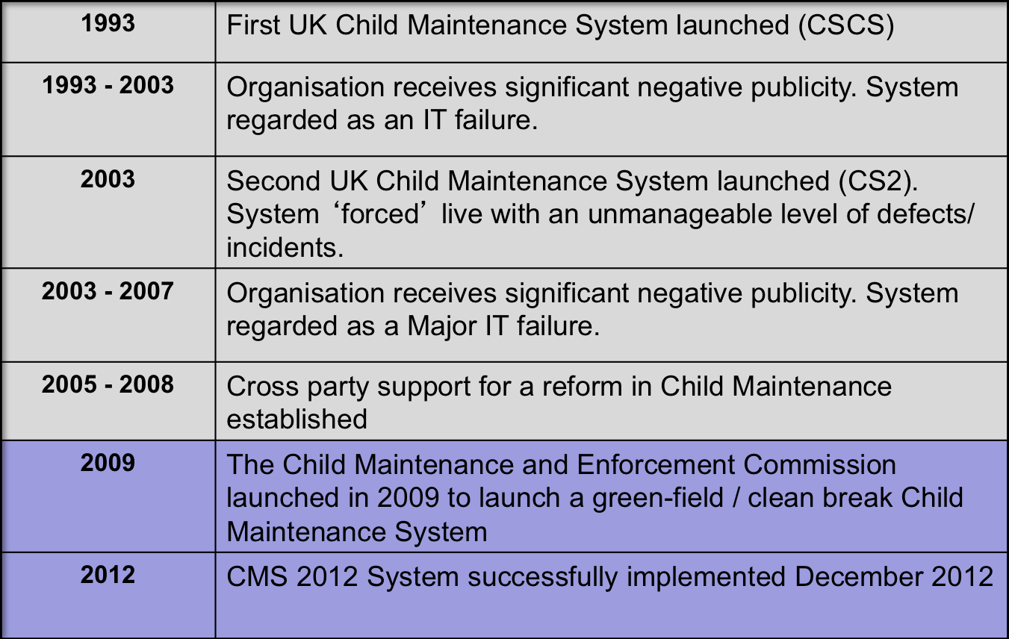
A High Level Timeline of Child Maintenance
Notes:
So back to this specific study.
Above is a potted timeline of Child Maintenance, you can see a theme here. It’s third time lucky. It’s taken three attempts to get Child Maintenance right and there are a number of reasons for that, but it’s safe to say that for 15 years as an organisation our stock was not high.
And I think this story of how IT had been developed and implemented is really important in the context of the following case study, I’d like you all to hold on to the concept that this organisation had a reputation for “doing IT” rather badly.
Sir Archy Kirkwood, chairman of Work and Pensions Committee, described the situation as "a systemic, chronic failure of management right across the totality of the agency.“ In November 2005, Tony Blair admitted that the CSA is "not properly suited" to its job, amid reports that for every £1.85 that gets through to children, the CSA spend £1 on administration.
So in 2009 we recruited a load of people and effectively decided to create a new organisation. Shut ourselves off from the old damaged legacy organisation and when the new system is delivered and stable, legacy cases would transition onto the new system.

Slide 8
CMS 2012
Core Component | Function
Siebel (Public Sector) | CRM System
BaNCS | Payments
Documentum | Document Repository
Adobe | Letter Creation
Oracle Policy Automation | Rules & Business Policies
Hopewiser | Address Validation
Websphere Portal | Web Portal
BT Genesis | Telephony Integration
WebSphere Process Server | ESB
Experian Bank Wizard | Bank Acc Validation
Notes:
Developed by TCS
Commissioned, Assured and integrated by DWP
Hosted Primarily on AIX - IBM P770, with some X86/RedHat and Windows.
Primarily Oracle 11g DBs.
Build around the following integrated COTS components
The system communicates with 25+ interfaces

Slide 9
The Problem…
Though, CMS 2012 was viewed as a Government IT success, the Initial Production deployment took 8 weeks
Subsequent releases anticipated to take at least 1 week and require total business outage during that period
Developer and Operations relations in crisis
Pathfinder approach led to configuration issues
Notes:
In December 2012 we delivered the system to great acclaim. It functioned as expected, we had a few teething issues as one would expect, some performance issues. But by professional standards and within government it was a viewed as an exemplar delivery.
However there was this underlying and enormous ticking time bomb of an issue.
The initial production took 8 weeks to deploy, we we’re greenfield until we switched the system on, we didn’t have any clients or cases, it didn’t really impact the business. There’s a number of reasons it took so long to build and a lot of these were one time only issues, but a key driver was that the build was a complex and largely manual deployment.
It quickly became evident that any future release would require significant business downtime, 1 week plus.
From a stakeholder and political perspective, you can kind of see where this is going.
Had we delivered a turkey? A third unwieldy and unfit for purpose Child Maintenance System?
Yes it will work for 6 months to a year, but after that it’s stuffed.
Quite often with these things there’s someone else to blame, the business didn’t articulate what it wanted properly at the requirements stage, but this was very much a technical issue.
Our reputation was at stake. We risked going from hero to zero.
But the silver lining is that it was very much in our gift to solve.

Slide 10
Why did the build take so long…?
Multiple, lengthy, manual steps
Significant scope for human error
Prolonged defect & incident resolution
Damaged staff morale
Notes:
Siebel build document ran over 300 pages.

Slide 11
How did we end up in this situation?
Complex system
Poor Dev > Ops > Hoster relationship
Pressure to deliver
Greenfield organisation, low maturity level
Notes:
Complex system, multiple customised COTS packages, secure container, 25+ external interfaces
Dev / Ops relationship, sat in different places, infrastructure team viewed as inferior.
System built with ease/speed of deployment low on the priority agenda.
Built to an aggressive schedule
As an integrator the organisation form an IT perspective was at a relatively low level of maturity. Being greenfield was a mixed blessing.

Slide 12
The Solution - Automation
It became clear early on that Automation would likely be the solution to our problem
Products identified (MidVision – Rapid Deploy, Subversion)
Development approach agreed
Team established
Notes:
How did we select that product? Via a proper commercial process – it also helped that a number of our infrastructure team were familiar with the tool and development process.
Siebel automation developed in JV with Midvision, they hadn’t done it before.
It was felt that we had the right level of skills to develop automation for the remaining scope in house.
Small team recruited, strong mix of young and eager developers and experienced external contractors.

Slide 13
Release Schedule
  Release 22 [ June 2013] OPA, Hopewiser, Experian Bankwizard and BaNCS Adapter
  Release 23 [Sept 2013] Siebel Phase I, Process Server, Adobe, Documentum Content and Documentum Web
  Release 24 [March 2014] Siebel Phase II, BaNCS and Portal
Notes:
Used a team of contractors and young eager developers.
Proof of concept at R22, used these products to develop the building blocks.
WPS and Siebel were critical path.
Deploy components as they became available, agile approach - linked to major releases R23 – R24

Slide 14
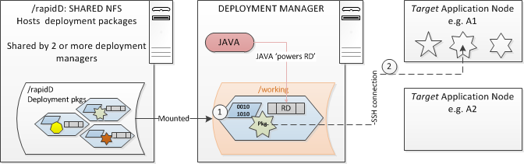
How
The package comprises RD commands, environment files, instruction and sequencing files and application codes.
Powered by Java, Rapid Deploy (RD) sitting on the Deployment Manager (DMGR) ‘reads’ the instruction files and picks the required software component. The environment files tell it where the target system is and its setup e.g. folders. It then connects to the target system and installs the code package. A deployment log is generated at the end of the process.

Slide 15
Operating Process
Owner | Step
Hoster | Set up the environment { PM has to engage MRIF, HP’s AIX team} Install Java on deployment managers and target application nodes Set up secure connections between DMGR and nodes Provision shared NFS includes obtaining SAN
CMG | Authorise SAN requests and RIs
Hoster | Request HP profile information for the hosted platform including target nodes
AD | Create the deployment packages and transmit to HP
Hoster | Stage the deployment packages on the shared NFS
Hoster | Run the pre-checks
Hoster | Initiate the deployment from the DMGR
Hoster | Check that deployment is complete and send logs onto TCS
AD | Developers review logs and sign-off that Deployments has completed satisfactorily
Notes:
Highlight the Pre Check and the confidence it gave the organisation.

Slide 16
Business Outcomes
Faster Deployments - By the second release (R23) we’d met the initial business objective, the third (R24) was deployed in under 10hrs. Deployment times per component reduced by at least 40%
Cost – savings of £2.2 Million (conservative estimate)
Multiplicity - Automation allowed for components to be deployed in parallel, contributing to significantly reduced deployment time
Repeatability - Once a stable deployment was achieved in test, we had near certainty that it would deploy cleanly into Production. Failed deployments became a thing of the past.
Improved performance
Significantly improved supplier relations and staff morale
Improved Efficiency - Significantly reduced downtime across test and live environments, increased efficiency in terms of test environment utilisation
Lowered Wastage – lower document overhead
Notes:
The range of benefits the project delivered way exceeded the original business case. The business case was constructed around a specific and strategic problem.
The project significantly over delivered and provided us with a number of tertiary benefits.
But in many ways, I think the most visable benefit was human. The relationships that were built during the project and the healing that that tool allowed.

Slide 17
Overcoming the Challenges
Significant resistance within the AD on the ground level
Resistance and scepticism from the Hoster at a commercial level
Delivering through a challenging AD > Hoster relationship
Significant level of environment disruption experienced on first time deployments
Resource challenges
Developing automated solutions in some cases created friction between Dev and Ops
Notes:
AD insisted on pre – populating code deliveries with environment variables.

Slide 18
Legacy
A low cost, high benefit project
Met all objectives - minimal, moving to zero business outage during releases
Positioned for the Departmental Digital Evolution
Salvaged the reputation of IT as a department who can delivery quality solutions quickly and effectively
Reputation as being a technological leader within the UK Government
Provides the potential for us to utilise the more advanced capabilities within Rapid Deploy

Slide 19
What I can help with?
Delivering automation and DevOps in Government
Overcoming cultural barriers
Business benefits of automating deployments

Slide 20
What I need help with?
Producing better graphs
Where next?
Delivering DevOps in a constrained supplier/towers model

Slide 21
Questions

